Slide 1
We all grew up listening to stories of great courage shown by Superheroes
with magical powers.
These stories inspire us and act as building blocks of our character.
Who is your favourite superhero?
What is their superpower ?
Each of us has a Superpower,-something that we are very good at.
For example, somebody’s Superpower could be helping others,
singing or doing Math well, etc.
Superheroes don’t exist only in fairy tales, they exist in real life too

Slide 2
It is a new generation of Super- heroes.
These young Superheroes are children from different
schools and different parts of the country.
They realized their superpower, stepped up and
are changing the world. The two powerful words,
"I CAN" is their Superpower.
Join the movement of these new age superheroes.
Come, You CAN make a difference.

Slide 3
WHY IS KWC IMPORTANT?
To make the society believe that Children are not helpless and making a difference is possible.
To make Children believe in themselves and the power within them in making a difference in them and in the society.
To build in Self Esteem, Personal Power, Sense of Purpose, Responsibility in youth.
To recognize children not only for their academic achievements but also for being socially aware and proactive change agents in their community.

Slide 4
To create awareness that kindness is a Gift of God
and must be practiced everyday to make it a habit
Children are the future leaders and we must guide them
so that humanity is sustained
To respect society and give it back through Seva

Slide 5
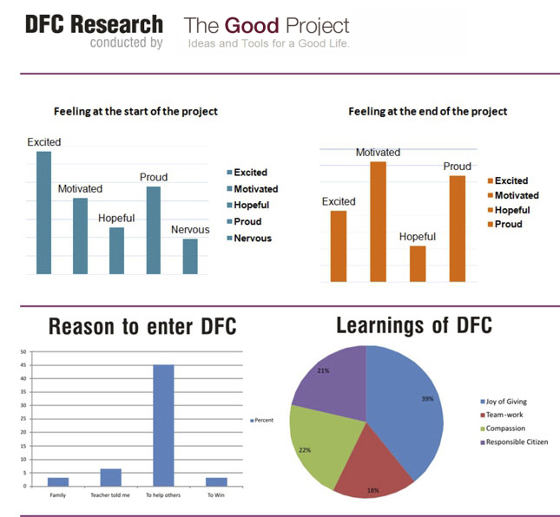
Excited= Hurray
Motivated= Dil maange more
Hopeful= All is well
Proud= How’s the Josh?

Slide 6
KEY LEARNING OF KWC
SYMPATHY V/S COMPASSION
Eg – an injured dog on the street
REASONS TO BE A KWC
LEARNINGS OF KWC

Slide 7
GAME OF GRATITUDE
Come up and share what is the one thing you want to
thank your mom for?
In everyday life, we forget to thank her for the basics
When we are cold and sick, a blanket keeps us warm.
How do we thank it ? By folding and keeping it well
How should we thank our mom for all she does?
Eg pick up toys
We are blessed. Its time to be a blessing. We are content.
So how do we thank God? By small acts of seva to those
in need

Slide 8




SUPERPOWER?
KWC offers a simple 4-step design process which develops the values of empathy,ethics,engagement and elevation
FEEL
IMAGINE
DO
SHARE

Slide 9
TARGET AUDIENCE FOR SEVA
SELF
SOCIETY
COMMUNITY
ENVIRONMENT

Slide 10
PROCESS
Children get into groups and deliberate what affects and stirs them.
The project should directly bother them in some manner.
The Project should be concrete and should have a long lasting impact.
The children should choose a project which will make them make a difference

Slide 11
"Being the Change, changes the being“
Superheroes are not in fairy tales - they are in every child who says I CAN!

